Slide 1
EXERCISES – Path planning
& ROS ISSUES
By Vuk Vujovic

Slide 2
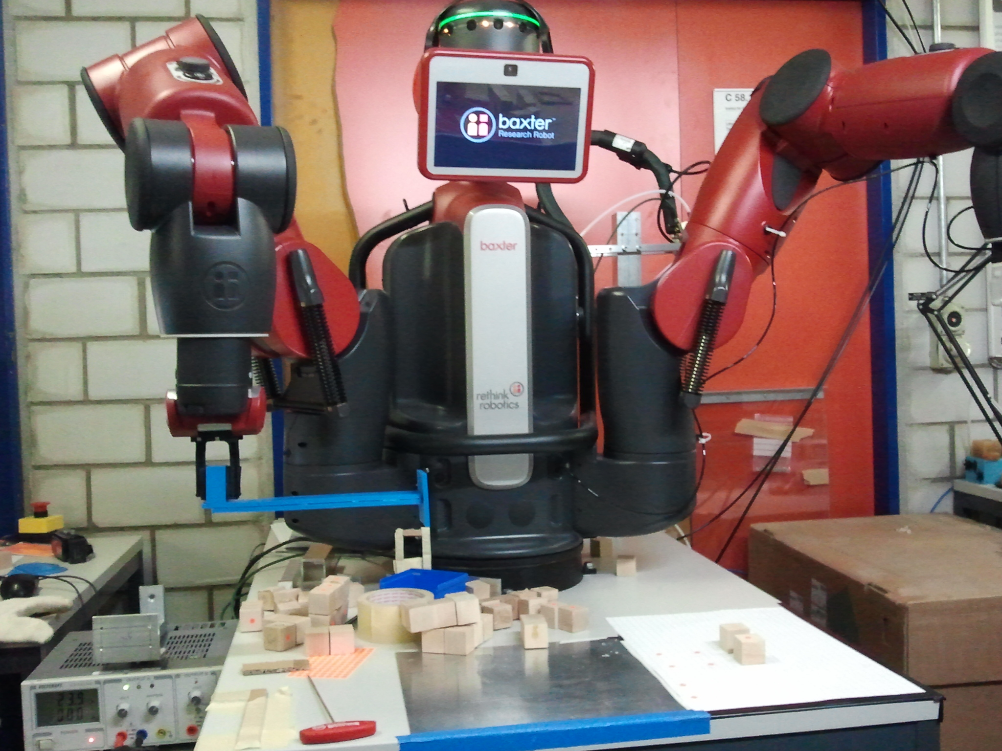
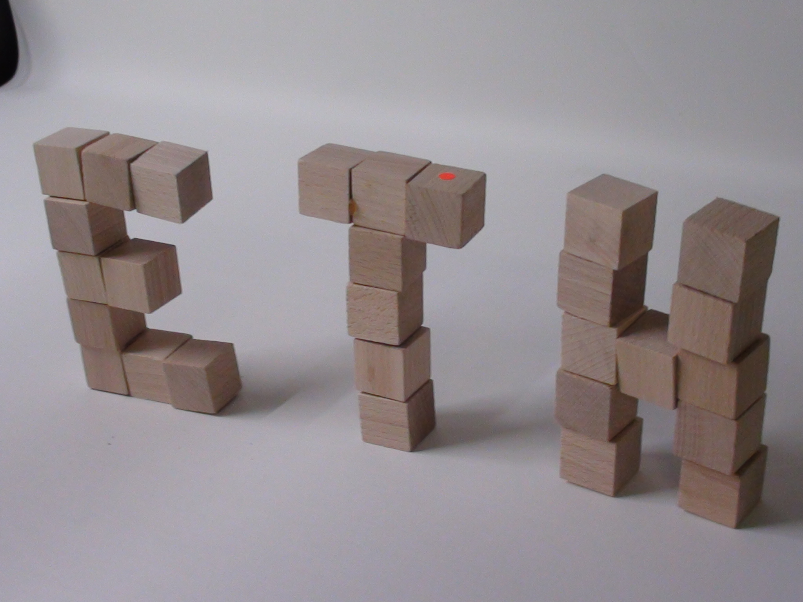
APPLICATIONS OF PATH PLANNING

Slide 3
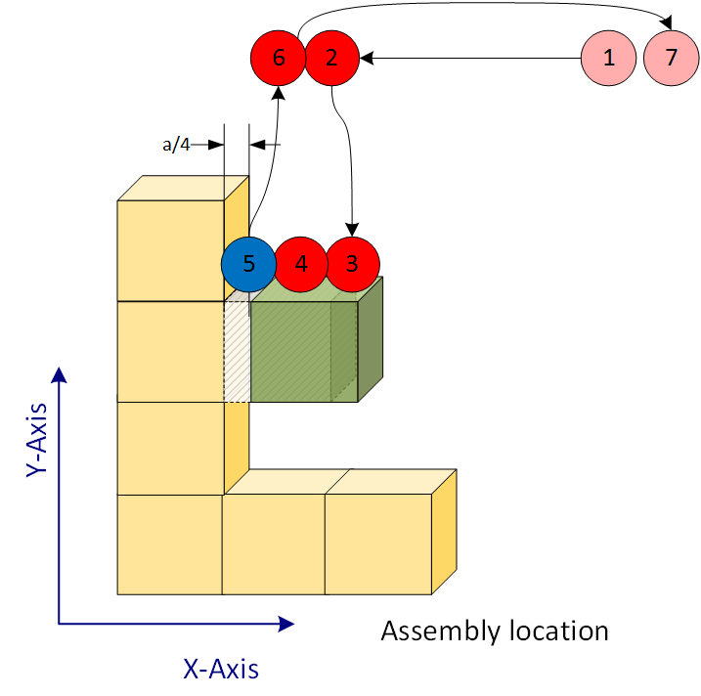
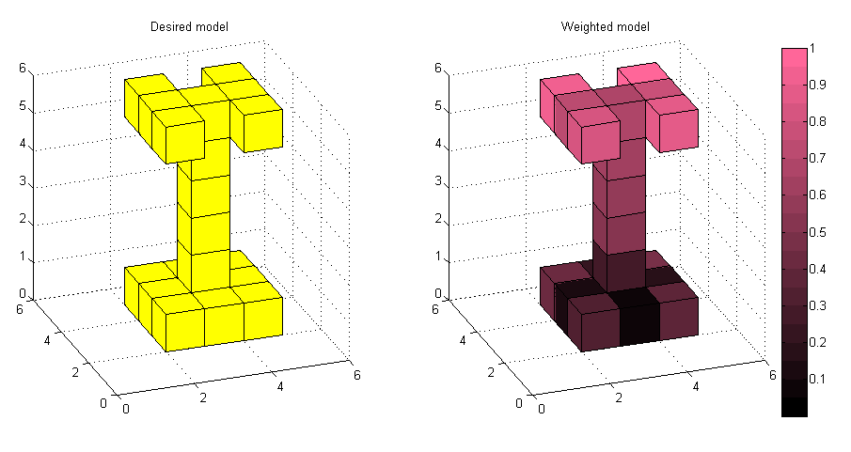
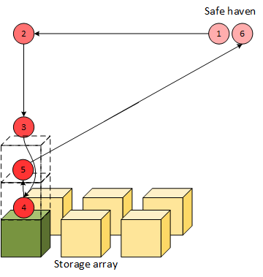
Potential Field approach vs. graph approach

Slide 4
A* Algorithm - recap
http://ashblue.github.io/javascript-pathfinding/

Slide 5
A* approach – discussion
Manhattan distance
Euclidean distance
Which one works better for you and why?
4-connected or 8-connected?
Which one is better for our case?
THINK ABOUT HOW IS YOUR ROBOT MOVING!
HEURISTIC SHOULD APPROXIMATE THE OPTIMAL DISTANCE FROM CURRENT NODE TO GOAL

Slide 6
ROS tf why and how?
System for describing relations among different coordinate frames
Keeps track of relations for you
Perfect for models with multiple bodies like robotic arms and humanoid robots
http://www.ros.org/news/resources/2009/nao_rviz.png

Slide 7
QUESTIONS?
http://www.globalrobots.com/uploads/images/Question%20mark%20robot.jpg

